Slide 1

Wecome Everyone

Slide 2
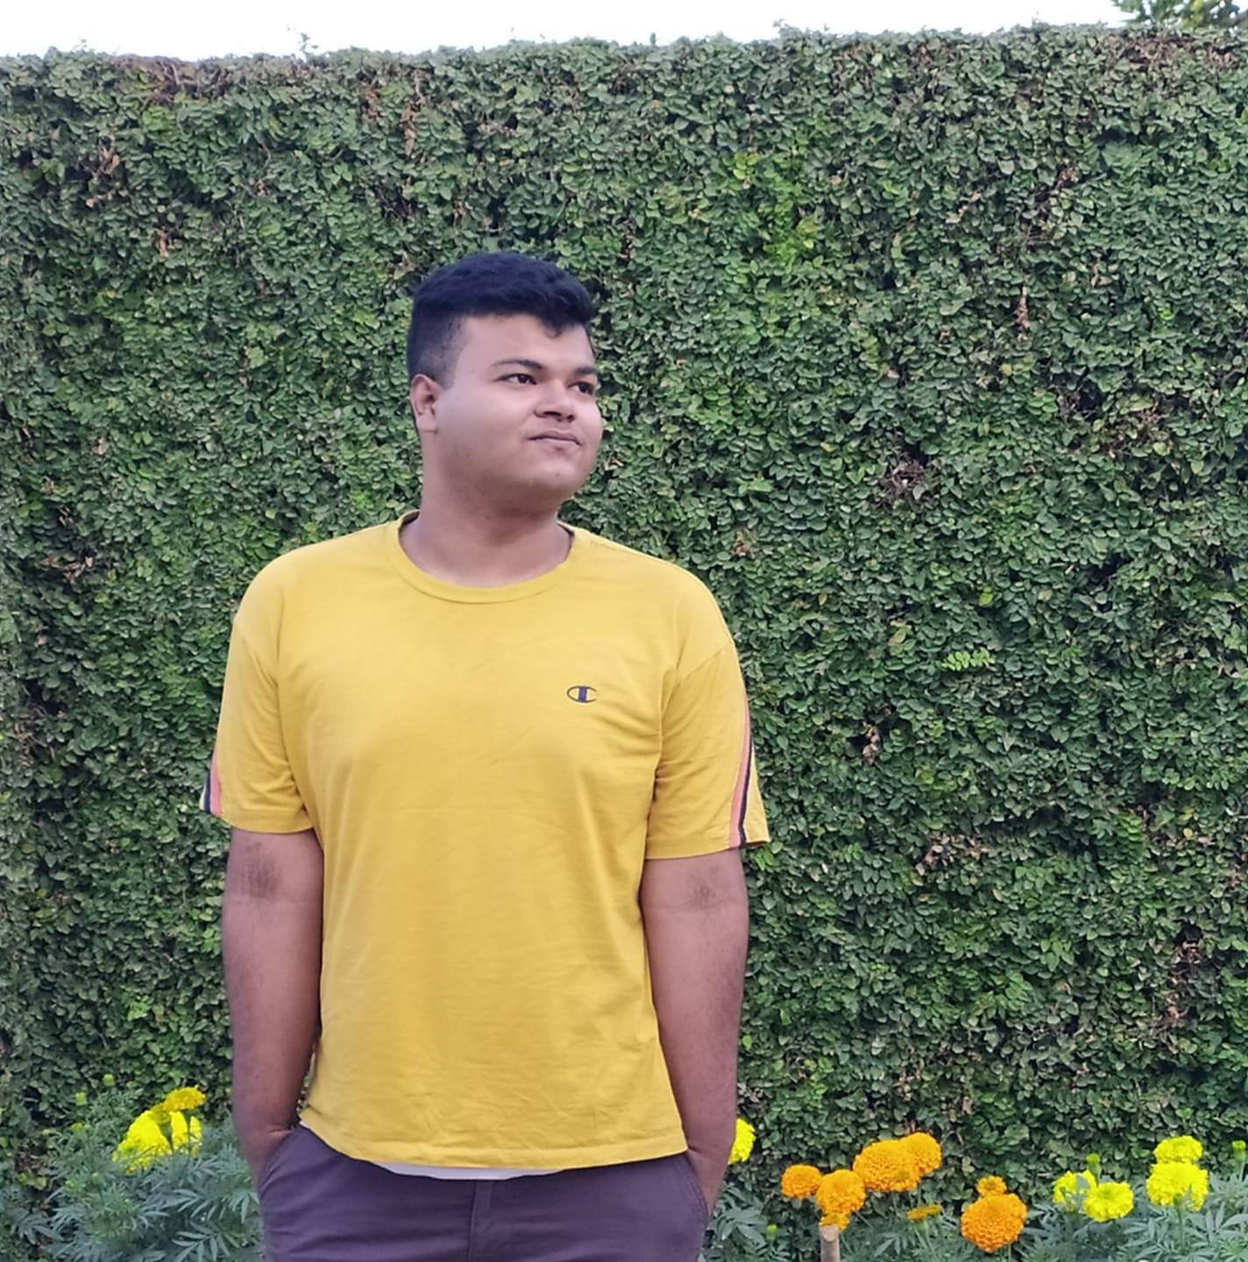
Introducing our team ‘Topsy Turvy 3.0’
1.Somapika Das (Leader)
Mail : ssomapika@gmail.com
Leading University
2.Asif Hossain
Mail : asifhossain976@gmail.com
American International University Bangladesh
3.Ashabul Eamin Hoq
Mail : ashabuleaminhoq@gmail.com
Shahjalal University of Science and Technology.

Slide 3
Team Presentation
Topsy Turvy 3.0
Here is our team presentation about the project we want to make for our ‘Educational System’.
Project Name : EDU-X (Provisional)

Slide 4


What is EDU-X and how will it contribute to our education system?
We believe in Education for all. Proper standard Education is needed for everyone. But due to the limited number of seats, we cant get a chance to study in prominent and renowned institutions. That’s why we cant get an opportunity to gather knowledge from famous teachers of those institutions. That is why we came up with the idea of gathering all the classrooms from renowned institutions on a single platform. We are calling it EDU-X.
With the help of EDU-X, students can easily access all the classes of prominent institutions (Live/Recorded). And can feel like a student of that institutions

Slide 5

Benefits of our website in ‘Educational’ sector
It will be ‘Student Centered’.
It will have ‘Increased student interaction’.
It will be ‘Cost Effective’.
It will be ‘Online Documented’.
‘Accessible 24*7’.
The study will be ‘Flexible’.

Slide 6
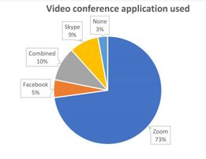
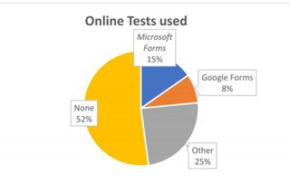
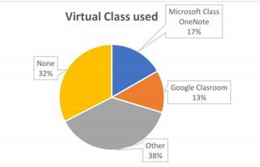
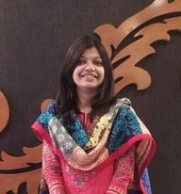
The Growth Of Online Education (Recent Stat):
Video conference app usage :
Virtual Classes and Test statistics :

Slide 7

Any Queries?

Slide 8
Thanks a lot for being with us.
That’s All

